Slide 1

CGB1201 – JAVA PROGRAMMING
Department of Artificial Intelligence and Data Science
Academic Year: 2024 – 2025 (Odd Semester)
Register Number : 2303811724322047
Name : JOYNURSINGH J
Year : II
Semester : III
Section : A
Date : 07.12.2024

Slide 2
Title of the Project
CURRENCY CONVERTER APPLICATION

Slide 3
Problem Identification
No Support for Multiple Currencies : Users often need to convert between multiple currencies, but many tools don’t support a wide range of currencies or make the process cumbersome.
Different Use Cases : Travelers, businesses, and individuals conducting international transactions may have different needs, but many currency converter apps don’t cater to these varied user groups.
Inconsistent Exchange Rates : Users often struggle with outdated or fluctuating exchange rates, making it hard to get accurate conversion values for travel or transactions

Slide 4
Objective
Real-Time Currency Conversion : To provide accurate and real-time currency conversion by fetching the latest exchange rates from a reliable and trusted source
User-Friendly Interface : To design a simple and intuitive interface that allows users to quickly enter amounts and select currencies for conversion.
Support for Multiple Currencies : To enable the conversion of amounts between a wide range of global currencies, including major and minor currencies, to cater to diverse user needs
Quick and Accurate Calculations : To ensure that users receive fast and precise conversion results, minimizing the chances of errors during manual calculations.

Slide 5
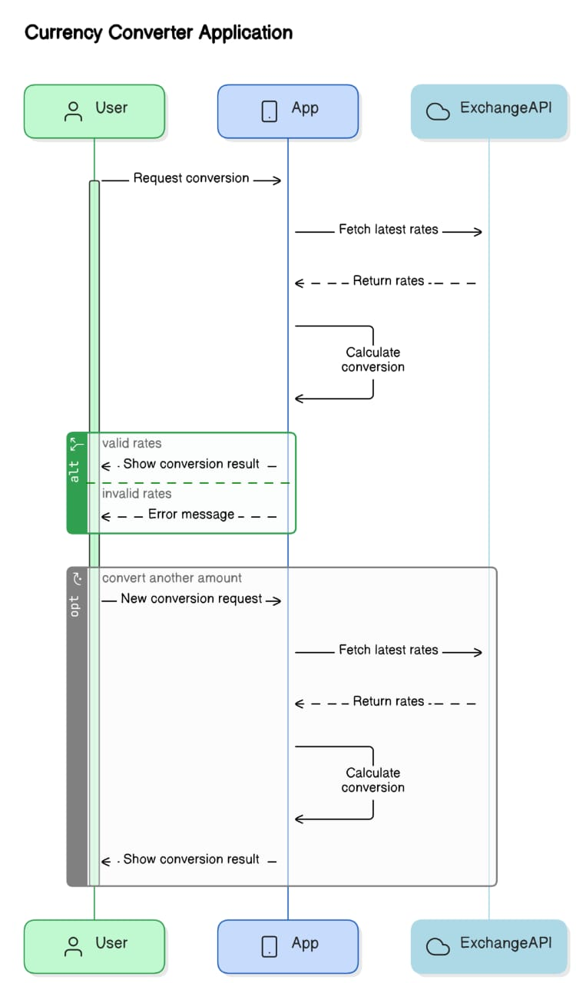
Proposed Architecture

Slide 6
Java Programming - Concepts Used
Classes and Objects: Classes like CurrencyConverter, ExchangeRateFetcher, Currency, and UserInterface.
Exception Handling:Handling network issues, invalid currency codes.
API Integration:To get real-time exchange rates.
User Interface :Java provides libraries like Swing.

Slide 7
List of Modules
Module 1:User Interaction Module
Module 2:Conversion Processing Module
Module 3:Data Management Module.
Module 4: Error Handling Module.

Slide 8
Module 1 Description
Module 1:User Interaction Module
Handles the interface between the user and the application.
Functions:
startApplication()
getInputAmount()
selectCurrencies()

Slide 9
Module 2 Description
Module 2:Conversion Processing Module
Manages the currency conversion logic.
Functions:
fetchExchangeRatesexchange ( )
rate validateInput()

Slide 10
Module 3 Description
Module 3: Error Handling Module
Manages errors and exceptions in the application.
Functions:
handleInvalidInputError()
handleAPIFetchError()
handleCalculationError()

Slide 11
Module 4 Description
Module 4:Data Management Module
Handles data storage and updating exchange rates.
Functions:
updateExchangeRates()
storeRatesLocally(rates)
getStoredRates()

Slide 12
Source Code
import java.awt.*;
import java.awt.event.*;
import java.util.HashMap;
public class CurrencyConverter extends Frame {
private final HashMap<String, Double> exchangeRates;
private TextField amountField;
private Choice sourceCurrency;
private Choice targetCurrency;
private Label resultLabel;
public CurrencyConverter() {
exchangeRates = new HashMap<>();
initializeExchangeRates();
setupUI()

Slide 13
Source Code
// Closing action
addWindowListener(new WindowAdapter() {
public void windowClosing(WindowEvent we) {
System.exit(0);
}
});
}
// Initialize some predefined exchange rates
private void initializeExchangeRates() {
exchangeRates.put("USD", 1.0); // Base currency
exchangeRates.put("EUR", 0.92);
exchangeRates.put("INR", 82.67);
exchangeRates.put("GBP", 0.78);
exchangeRates.put("JPY", 130.5);
}
// Create GUI
private void setupUI() {
setTitle("Currency Converter")

Slide 14
Source Code
setSize(400, 300);
setLayout(new GridLayout(6, 2));
Label amountLabel = new Label("Amount:");
amountField = new TextField();
Label sourceLabel = new Label("From Currency:");
sourceCurrency = new Choice();
for (String currency : exchangeRates.keySet()) {
sourceCurrency.add(currency);
} Label targetLabel = new Label("To Currency:");
targetCurrency = new Choice();
for (String currency : exchangeRates.keySet()) {
targetCurrency.add(currency);
}
Button convertButton = new Button("Convert");
resultLabel = new Label("Converted Amount: ");
convertButton.addActionListener(new ActionListener() {
public void actionPerformed(ActionEvent e) {
convertCurrency();
}
})

Slide 15
Source Code
private void convertCurrency() {
try {
double amount = Double.parseDouble(amountField.getText());
String from = sourceCurrency.getSelectedItem();
String to = targetCurrency.getSelectedItem();
if (from.equals(to)) {
showErrorDialog("Source and target currencies must be different.");
return;
}
double convertedAmount = calculateConversion(amount, from, to);
resultLabel.setText("Converted Amount: " + String.format("%.2f", convertedAmount));
} catch (NumberFormatException ex) {
showErrorDialog("Please enter a valid numeric amount.");
}
}

Slide 16
Source Code
private void showErrorDialog(String message) {
Dialog errorDialog = new Dialog(this, "Error", true);
errorDialog.setSize(300, 150);
errorDialog.setLayout(new FlowLayout());
Label errorMessage = new Label(message);
Button okButton = new Button("OK");
okButton.addActionListener(e -> errorDialog.dispose());
errorDialog.add(errorMessage);
errorDialog.add(okButton);
errorDialog.setVisible(true);
}
// Update exchange rates dynamically (future use or manual updates)
public void updateExchangeRates(String currency, double rate) {
exchangeRates.put(currency, rate);
}
// Main entry point
public static void main(String[] args) {
CurrencyConverter converter = new CurrencyConverter();
converter.setVisible(true);
}
}

Slide 17
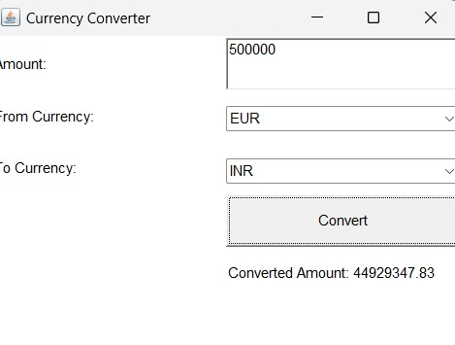
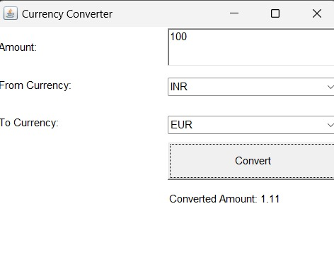
Results

Slide 18
Conclusion
In this project, I have developed a Currency Converter Application with an external AWT to fetch real-time exchange rates.
The application allows users to quickly convert amounts between different currencies.

Slide 19
Thank You
Any queries???

